Slide 1

How it Works: Pesticide Registration in Maine
Julia Vacchiano
Pesticide Registrar & Water Quality Specialist
Agricultural Trade Show – January 2026

Slide 2
BPC Product Registration
All pesticides in the state need to be registered with the BPC
Before sale, but also before shipped through or brought through a port in the state
If it is within the borders of Maine, it must be registered with the BPC
Maine requires yearly registration for every pesticide
Companies submit label packages for review and initial registrations, and are active from January 1st until December 31st

Slide 3

FIFRA
Federal Insecticide, Fungicide, and Rodenticide Act
Statute that governs the registration, distribution, sale, and use of pesticides in the United States
First enacted in 1947 with major revision in 1972
Ensures Safety
Mandates Labeling
Enforces Compliance

Slide 4
Why is this information important for applicators?
Why is it important for the BPC to share?
- Transparency
Full understanding
Expanding language for all to facilitate more accurate and meaningful conversations between all parties
What does this mean to you as an applicator?
Power in knowledge
Ability to recognize industry changes to make more informed decisions
How will this presentation benefit me as an applicator?
Throughout the presentation there will be text box "pop-ups" that will highlight how the information on that slide can directly benefit your applications, your business, or you as an applicator.

Slide 5
Maine Registration Types
Section 3
Adjuvants
25(b) Minimum Risk
2(ee)
24(c) SLN
Section 18 - EUP

Slide 6
Most Common Registration Types
Section 3
Adjuvants
EPA Registered
State Registered
EPA Exempt
State Registered (ME)
Minimum Risk – 25(b)
EPA Exempt
State Registered (ME)

Slide 7

Section 3 – EPA Registered
Section 3
Federally Registered
Assigned an EPA Registration Number*
Have an Approved EPA Master Label
  The BPC Registrar (me) makes sure they match
  Always available publicly
Maine can be stricter, but not LESS
BPC can not reject a product unless there is a reason outlined in Maine statute, or rule.
*BENEFIT*
Help create and shape state pesticide landscape
Mistake? Report it and we can request a fix from either the EPA or the company

Slide 8
EPA Registration Numbers
Section 3
1234
45
67890
-
-
EPA Company number of the “Basic Registrant” aka the owner of this formula
Product number
This is the 45th product company “1234” has registered with the EPA
Supplimental Distributor EPA company number
Company “67890” has purchased the rights to sell company “1234”s formula #45

Slide 9


EPA Registration Numbers
Section 3
*BENEFIT *
Knowledge is buying power
Clean Earth Wipes
Super Tough Muscle Wipes
100% Good for the Planet!
ONLY For Tough Mean Guys
008 – 12 - 1234
008 – 12 - 4567
Same Formula

Slide 10




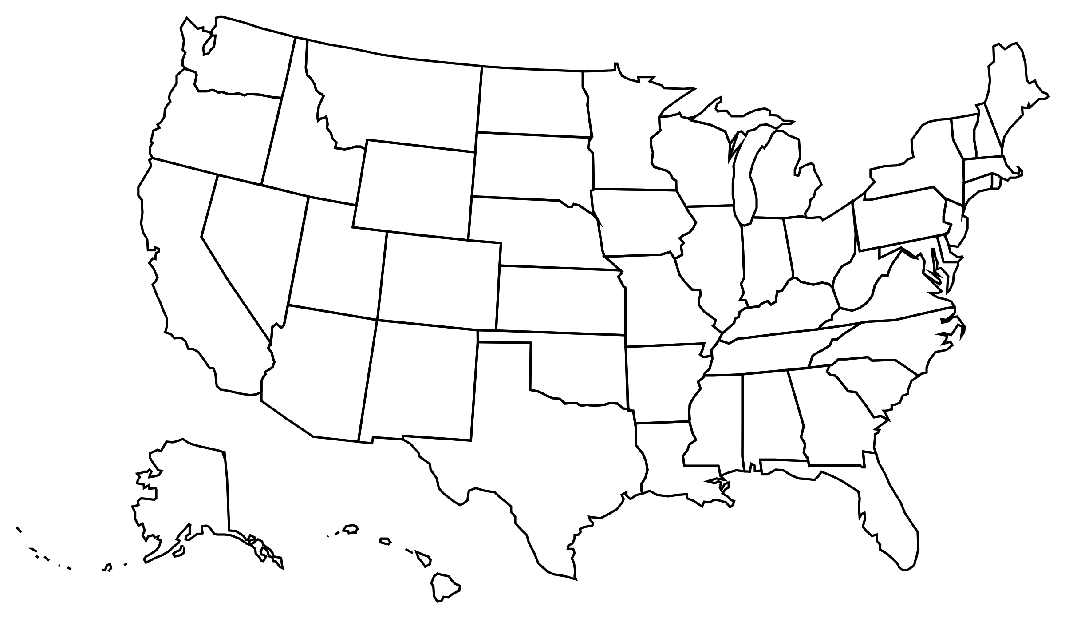
Path to Registration
Section 3
Active Ingredient
New?
Existing?
Company develops a formula containing approved active ingredient
Company submits specific formula to EPA for approval
    Claims
Efficacy Testing
Risk Assessment
Long, $$$ process
EPA approves formula
It is issued and EPA registration number and an EPA Master label
Company sends approved label, container label, and formula (ME) to all 50 states individually for approval

Slide 11
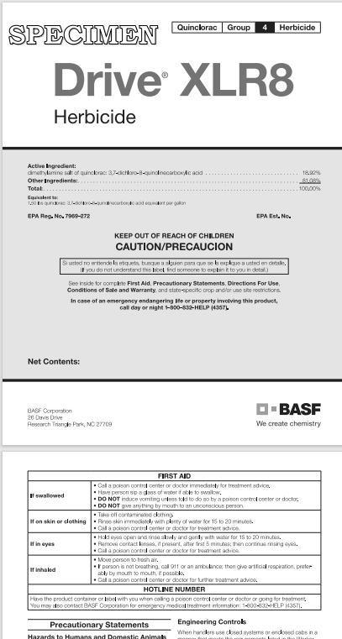
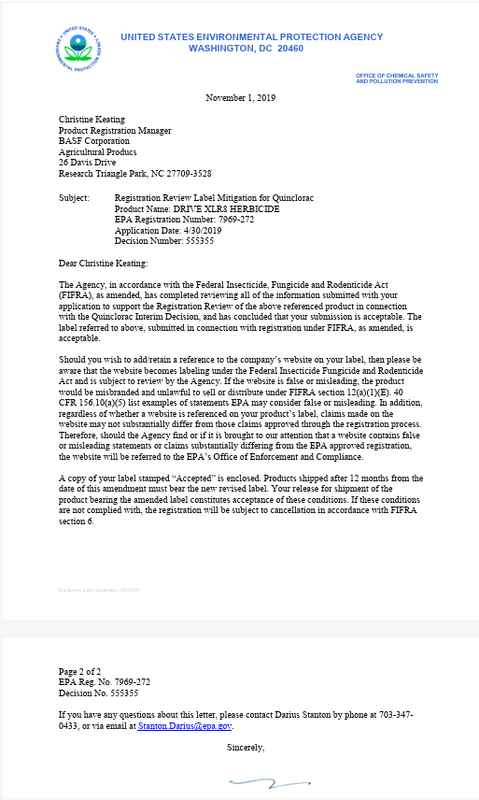
Maine
Registration
Section 3
Section 3
CSF – Confidential Statement of Formula
Safety Data Sheet
Container Label
Maine Laws and Restrictions

Slide 12
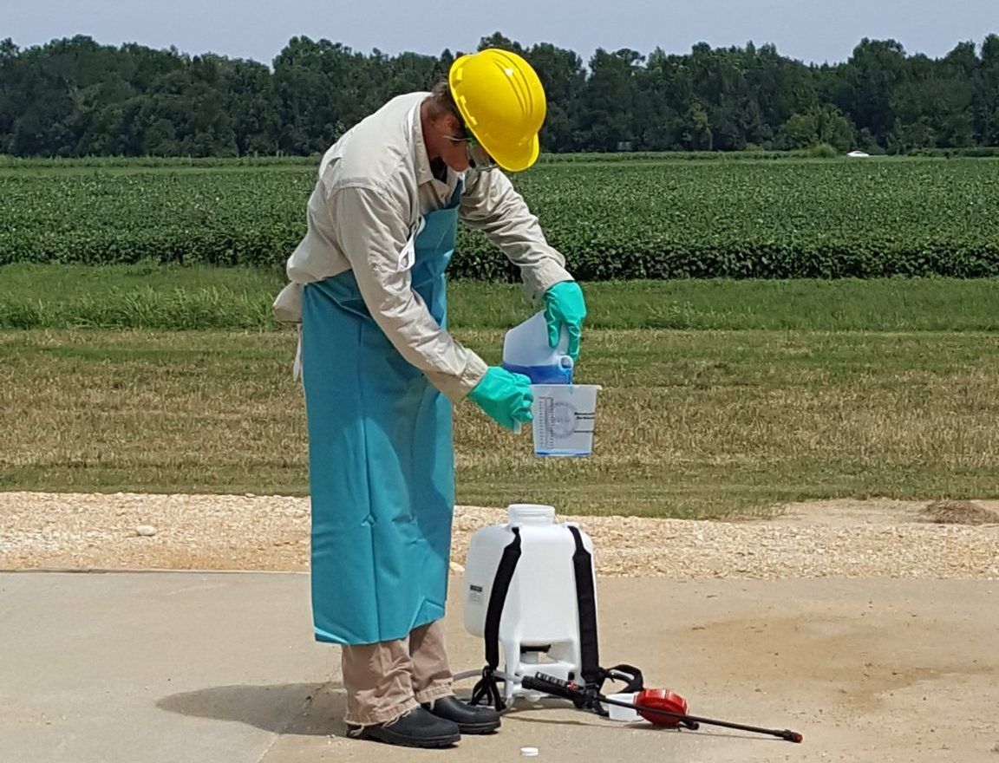
Adjuvants
Section 3
*BENEFIT *
Maintaining Compliance and Keeping Accurate Records
Federally Exempt
Registered by some states
  Maine Registered (2022)
Pesticide by Maine Definition
"Spray adjuvant" means any wetting agent, spreading agent, sticker, deposit builder, adhesive, emulsifying agent, deflocculating agent, water modifier or similar agent that is intended to be used with any other pesticide as an aid to the application or the effect.
"Pesticide" means:
A. Any substance or mixture of substances intended for preventing, destroying, repelling or mitigating any pests; [PL 2021, c. 673, §2 (NEW).]
B. Any substance or mixture of substances intended for use as a plant regulator, defoliant or desiccant; and [PL 2021, c. 673, §2 (NEW).]
C. Any substance or mixture of substances intended to be used as a spray adjuvant.
Image: Alabama A&M and Auburn Extension

Slide 13
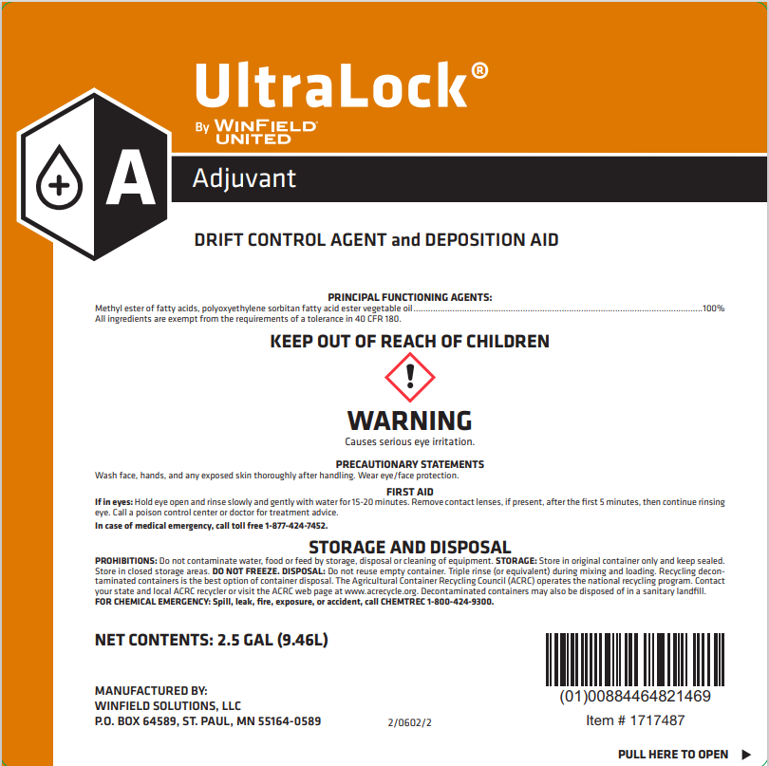
Path to Registration
Adjuvants
Company develops a formula
Submit label and supporting documents to states that register adjuvants
(ME, CA, WA.. Etc.)
Approval by State Pesticide Agency
(BPC)
No EPA Blueprint or allowed language
Responsibility of the BPC
Cooperation between states

Slide 14

Section 25(b) – Minimum Risk
Federally Exempt
EPA 6 Conditions*
Claims and efficacy data
  Pests of public health concern
State Label and Website Review
State Registered
Minimum Risk does NOT mean no risk
Image: Lost Coast Plant Therapy

Slide 15
EPA 6 Conditions
25(b) Minimum Risk
1. Active Ingredients
2. Inert Ingredients
3. Ingredient Names
EPA list + common food commodities
Can only be called what EPA says they’re called
ONLY EPA set list
4. Health Related Claims
5. Company Contact Info
6. Label Statements
Can not claim to prevent or cure disease
No false or misleading claims
Full Contact Information

Slide 16
Path to Registration
25(b) Minimum Risk
Efficacy is checked by Maine
Only for public health pests (mosquitos, ticks, and bed bugs)
Home-brewed products for sale also need to follow these rules, these are not just rules for large producers
Company develops a formula
Submit label and supporting documents to states that register 25(b) products
(ME, IN, CO, PA., Etc.)
Approval by State Pesticide Agency
(BPC)
*BENEFIT *
Gain options, but also perspective on efficacy
Read labels more efficiently

Slide 17
Less Common Registration Types
2(ee)
SLN – 24(c)
EPA Exempt
State Reviewed
EPA Registered
Board Approved
State Registered
EUP – Section 18
EPA Registered
State Registered

Slide 18

2(ee) – Supplemental Labeling
Use for whitefly on Poinsettias
Federally Exempt
Maine Reviewed – On file with BPC
FIFRA Section 2(ee) outlines exemptions for using a pesticide “off label”
Presented by companies and distributors
For use IN CONJUNCTION with a Section 3 label – Section 3 must be registered
Must meet specific criteria
And aphids too
Section 3 Label
2(ee)

Slide 19
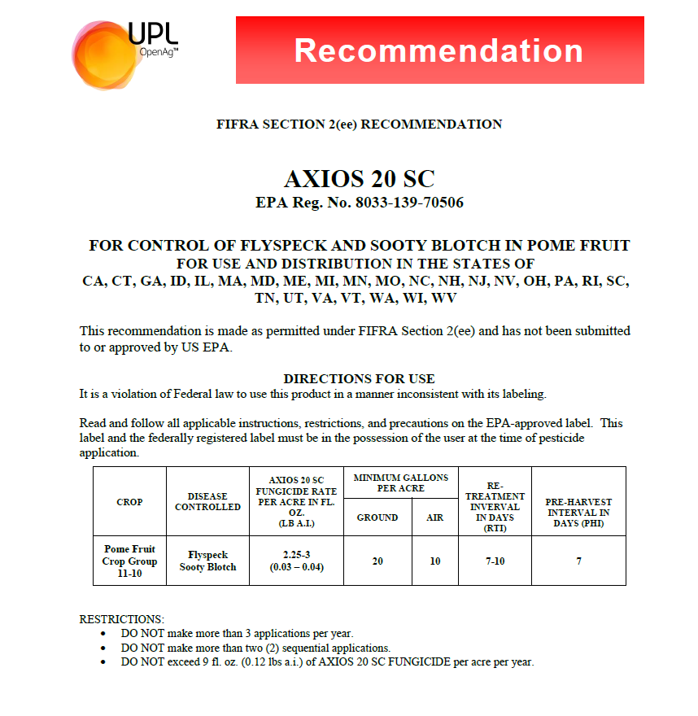
Exemptions
Section 3
2(ee)
Can ONLY be used when:
Applying a pesticide at any dosage, concentration, or frequency lower than specified on the label
Applying a pesticide against any target pest not specified on the labeling, to a crop animal or site on the label
Employing any method of application not prohibited by the label (unless the label specifies that it must only be applied by the listed methods)
Mixing a pesticide with a fertilizer, when mixture is not prohibited by the label
*BENEFIT *
Use products more effectively at a lower rate
More tools for pest problems

Slide 20
24(c) – Special Local Needs
Authority of FIFRA section 24(c) allows states to register additional uses of a federally registered product that are not on the label
A special local need (SLN)
  Addresses an existing or impending pest problem
  Solves a problem the SLA (BPC) has determined can not be solved by an existing federal registration
  Is based on satisfactory supporting information
SLNs address unique pests and geography
Provides Flexibility
Additional Information – Big Topic

Slide 21





Path to Registration
24(c) Special Local Needs
Confirmation and Establishment of Need
Identification of
Pest
State Approval
Federal Approval
*Used in conjunction with a Section 3 Label*

Slide 22
Active SLNs
24(c) Special Local Needs
*BENEFIT *
Manage highly specific pest issues on your farm with help from UMaine and the BPC
Arbotect – injection for Beech Leaf Disease (Exp. 2028)
Arsenal – increased surfactant rate with Glyphosate for pine and spruce species (Expired)
Asulox – to control bracken fern in wild blueberries (Exp. 2030)
Sandea – control of broadleaf weeds in blueberries (Exp. 2027)
Callisto – control of broadleaf weeds in lowbush blueberries (Exp. 2027)
Express – spot application to control bunchberries in lowbush blueberries (Exp. 2030)
Goaltender – for post-emergent weed control in broccoli (Exp. 2026)

Slide 23

Section 18 – Emergency Use
Allow for unregistered uses of pesticides to address emergency conditions
Limited use in a defined geographic area for a finite period
EPA interprets the definition of “emergency situation”
Urgent, non-routine
Requested by the state
Image: FIFRA Section 18 Emergency Exemption Program Information and Training Resource | US EPA

Slide 24

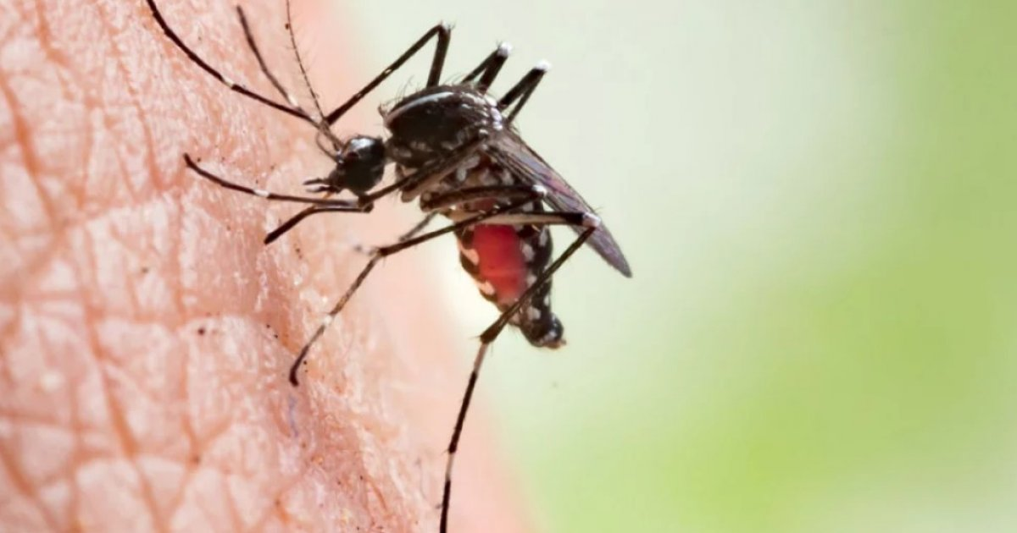
Types of Emergencies
Specific
  Significant risk to environment, endangered or threatened species, and to prevent major economic impacts
  1 Year
Quarantine
  Control the introduction or spread of an invasive pest not known to occur in the U.S.
  3 Years
Public Health
  Significant risk to human health
  1 Year
Crisis
  Can be applied to any type
  15 Days
ImageClose Up Photo Of Red Large Letters Spelling Emergency Stock Photo - Download Image Now - iStock
Image: Global dengue crisis unfolds in 2023, WHO raises alarm

Slide 25
Summary
General Registrations
Section 3: Federally registered pesticides with EPA approved labels
Adjuvants: Federally exempt but registered pesticides in Maine
25(b) Minimum Risk: EPA-Exempt pesticides with specific requirements that are registered in Maine
Specialized Registrations
2(ee): Allow for specific “off-label” uses like lower rates or unlisted methods of application
24(c): Provide flexibility for pest problems unique to Maine
Section 18: Urgent, time limited use used for emergency situations

Slide 26
Key Takeaways
  Buying Power: Understanding that different products may share the same formula helps make informed purchasing decisions
  Operational Flexibility: Utilizing specialized registrations provides specific tools and allows for more targeted and effective pesticide use
  Compliance & Safety: Understanding which labels you should have on hand during an application and how to read them with added context
  Applicator Influence: You can help shape the state pesticide landscape by advocating for changes in registration

Slide 27
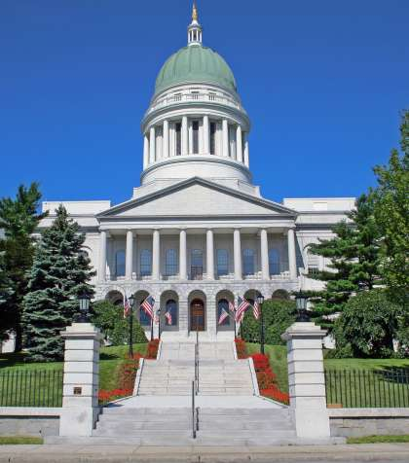
Resources and Information
  Pesticides are registered on a rolling basis, stay in contact with BPC with registration questions
  BPC Website
  BPC Public Meetings to hear conversation on registration decisions
  EPA PPLS: https://ordspub.epa.gov/ords/pesticides/f?p=PPLS:1
  BPC Registration Information: https://www.maine.gov/dacf/php/pesticides/registrants.shtml

Slide 28

Questions?
Thank You!
Julia Vacchiano
Pesticide Registrar & Water Quality Specialist
Email: julia.vacchiano@maine.gov
Cell: (207) 592-3278

